Slide 1
91896 EVIDENCE SCREENSHOTS
AVISHAI LUMANLAN

Slide 2
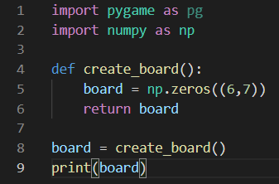
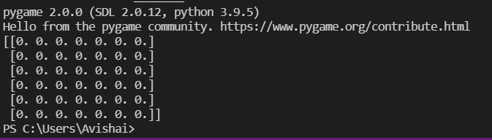
Start up code (Board Early Setup)
Code
Output In Terminal

Slide 3
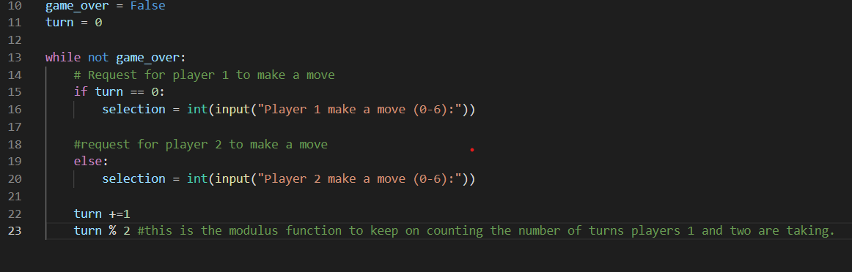
Basic Functions Code Startup
Code Output (Screen Recording URL)
https://streamable.com/ef628f

Slide 4
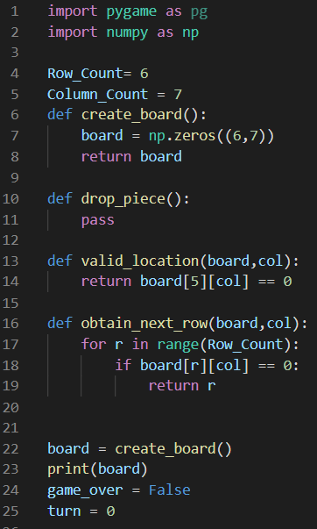
Startup Defs (as of 6/1/21)

Slide 5
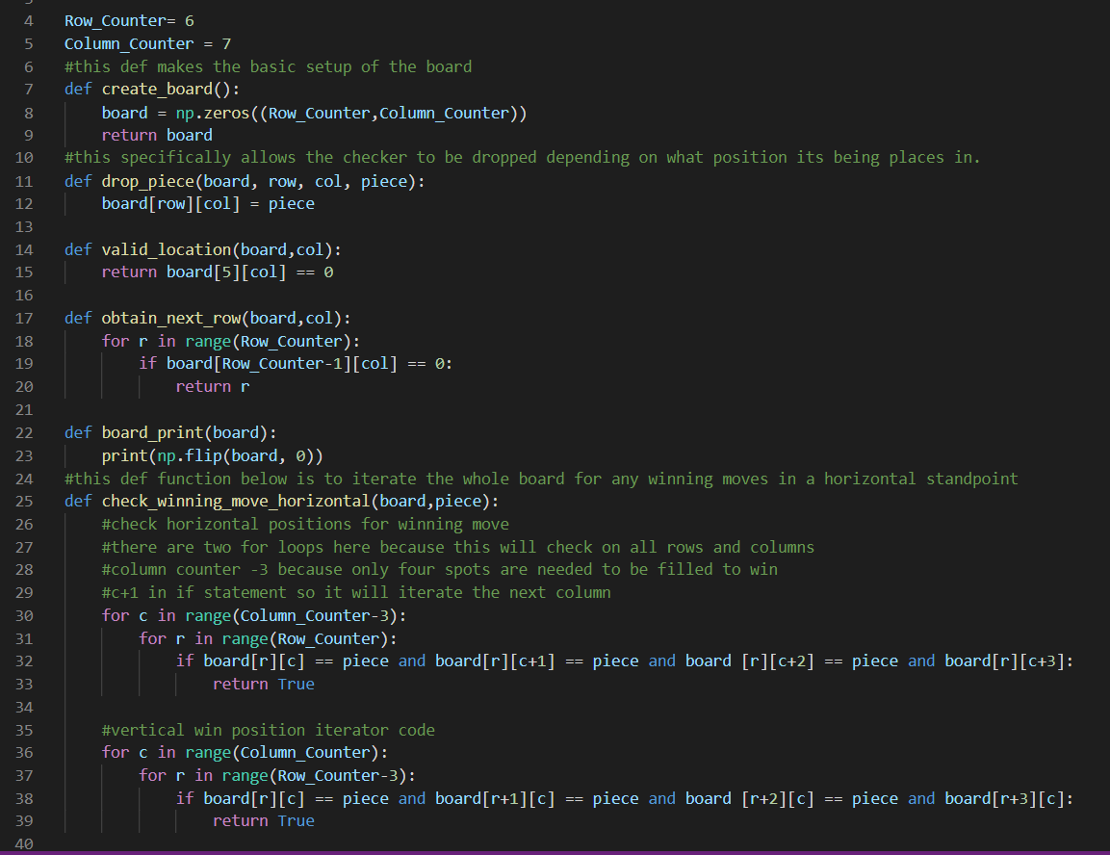
Updated Defs with game winning function
(as of 6/4/21)

Slide 6
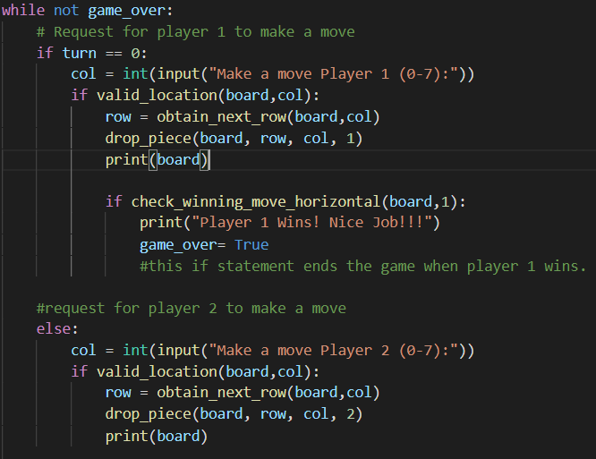
User requested functions (as of 6/4/21)
(game winning move statement included)

Slide 7
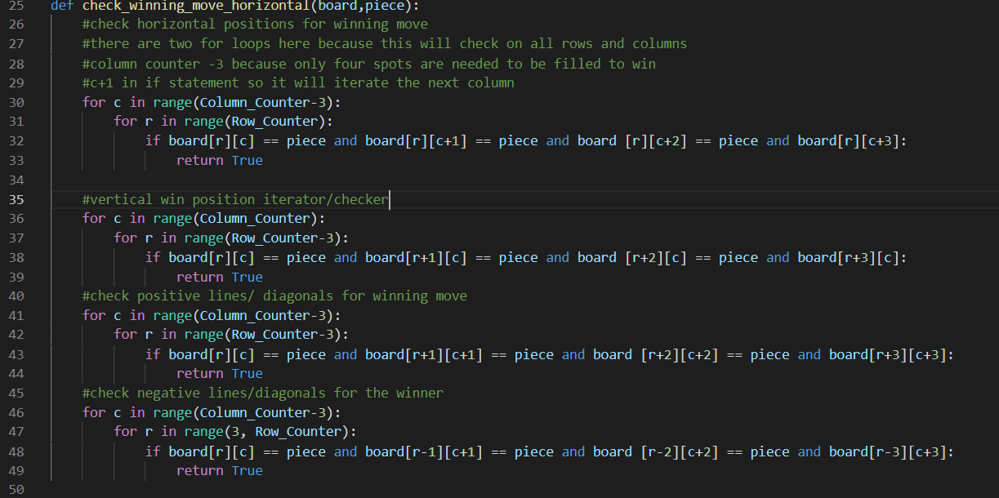
Game winning move iterator (6/8/21)

Slide 8
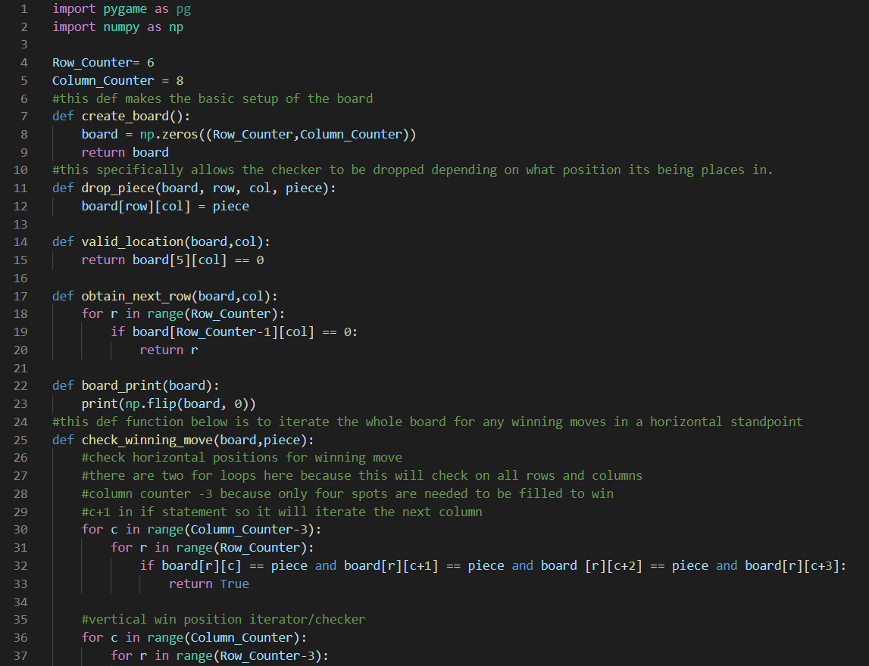
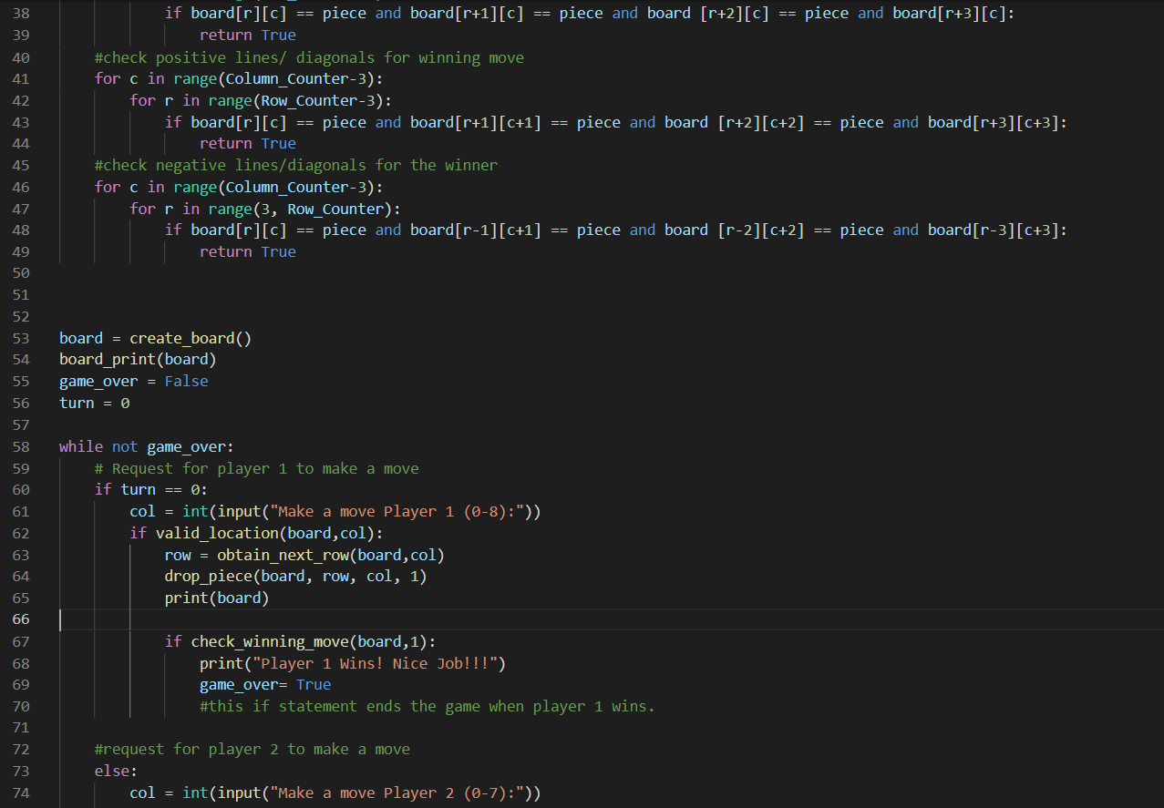
Full source code (as of 6/8/21)

Slide 9
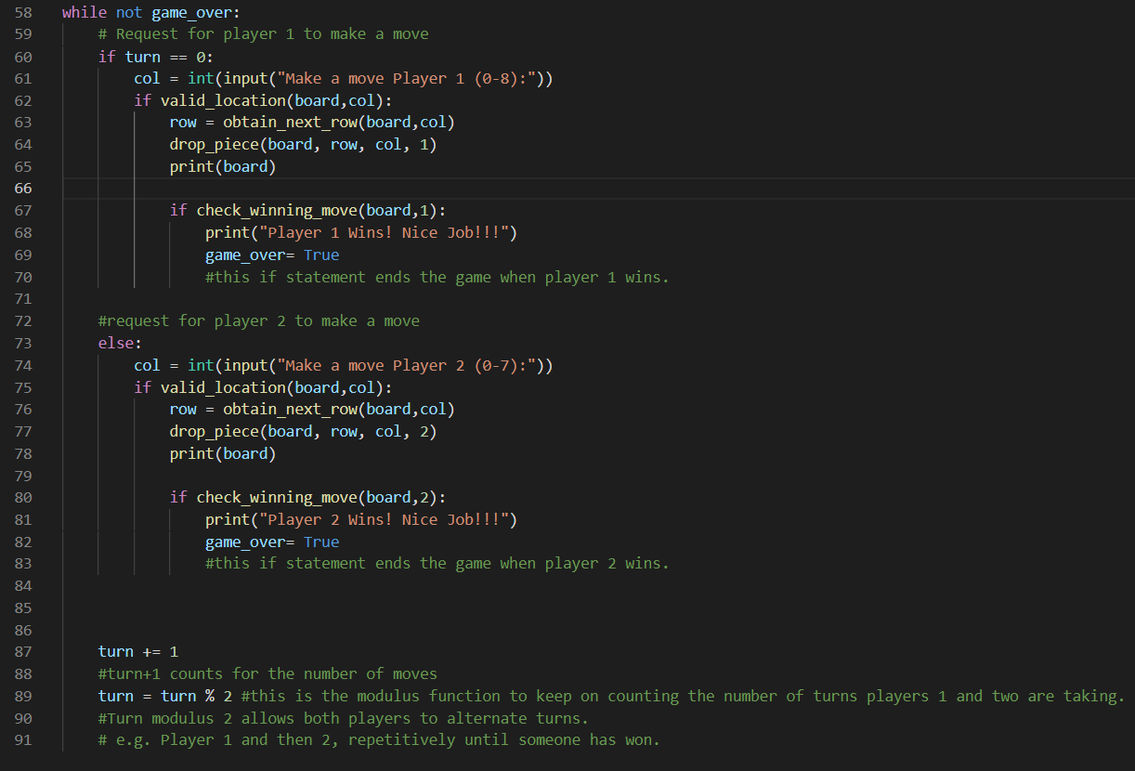
Full source code continued….

Slide 10
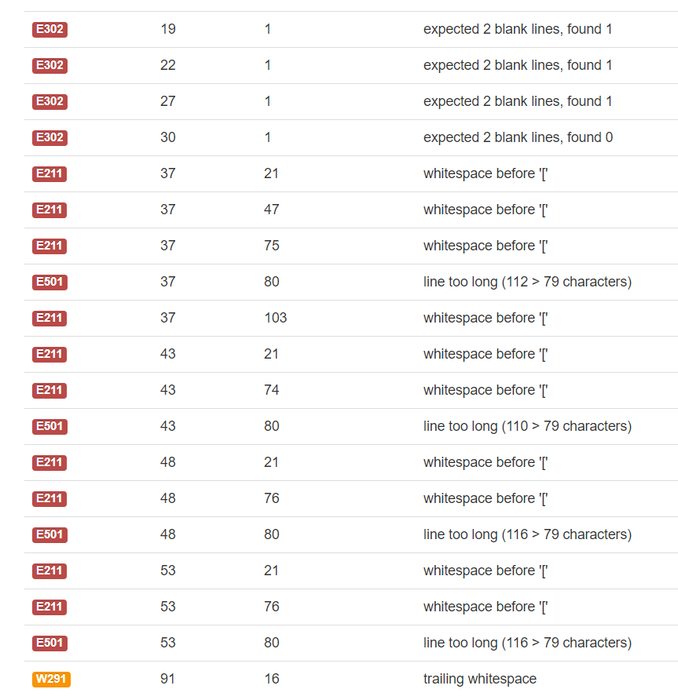
Pep8 Validation Errors

Slide 11
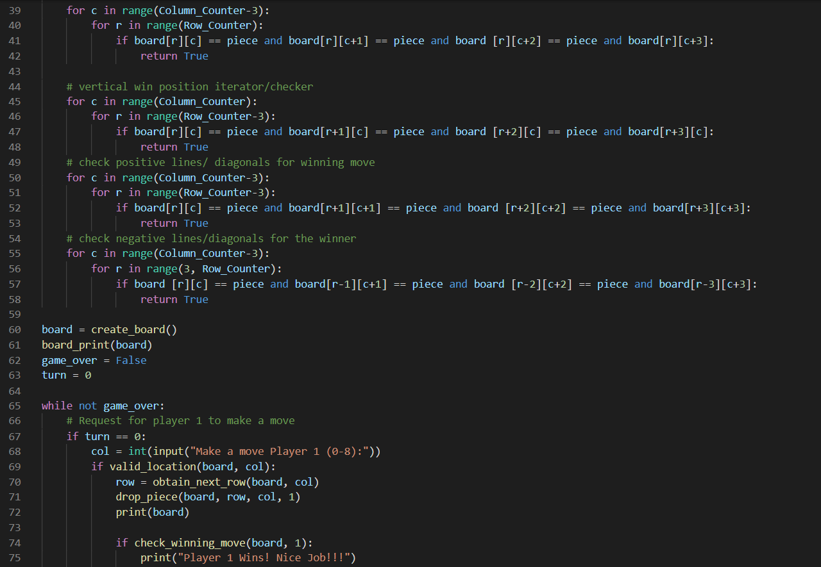
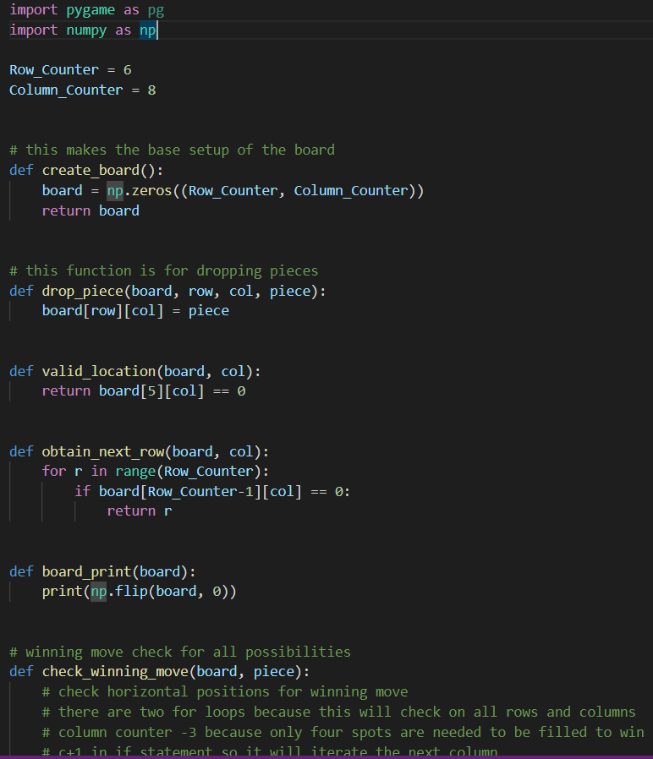
Code screenshot after

Slide 12
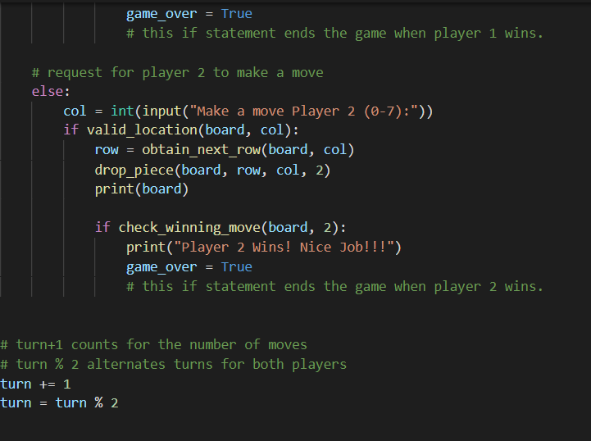

Slide 13
I had to fix my code with the PEP8 validator to ensure that the conventions of my code are valid and up to date.

Slide 14
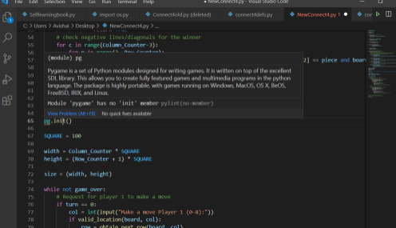
Pylint error before

Slide 15
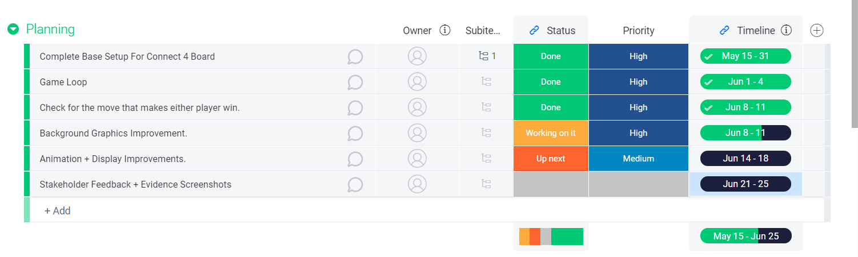
Plan status (as of 6/10/21)

Slide 16
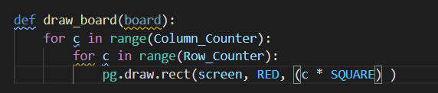
This here is the draw function for drawing the connect four board on pygame.

Slide 17
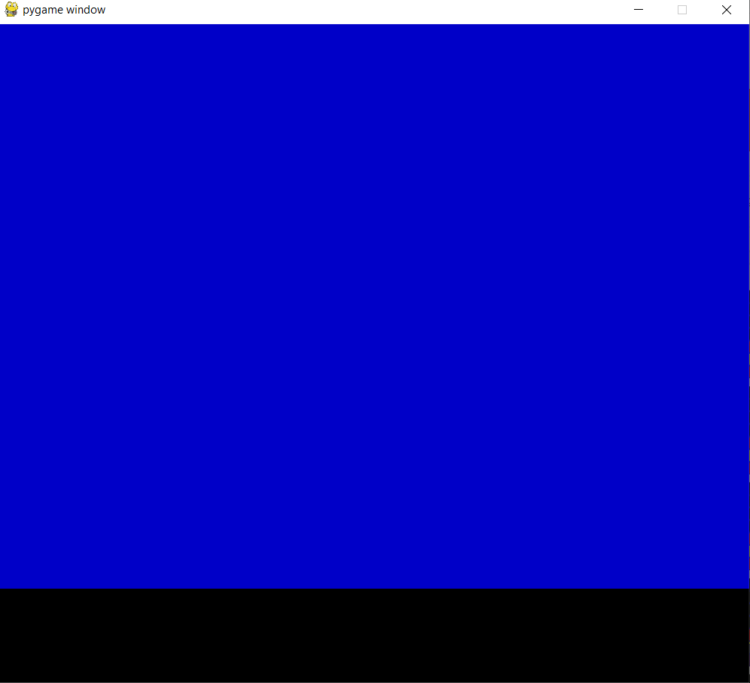
Pygame display testing outcome before

Slide 18
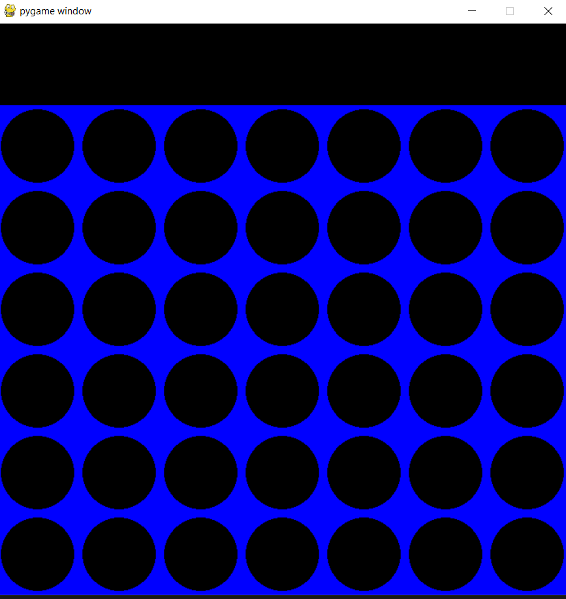
Pygame outcome now (as of 6/13/21)

Slide 19
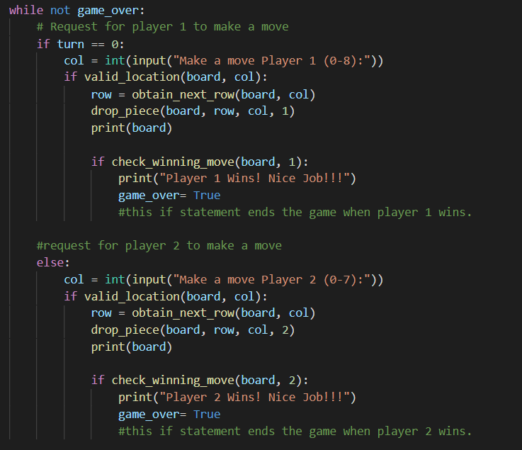
Major Improvement change before (code)

Slide 20
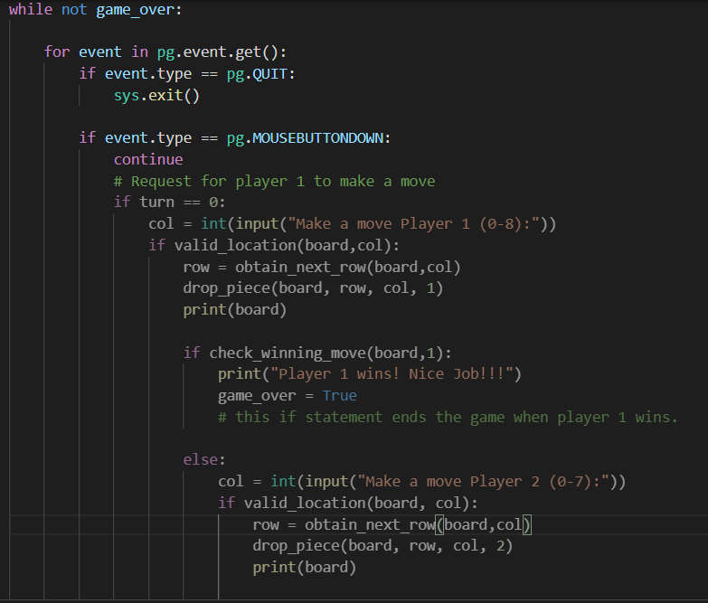
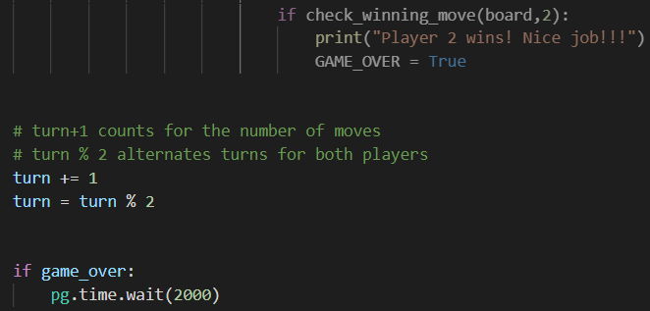
Game running code after

Slide 21
Comments on that major improvement
I made those changes in order for the connect four game to run smoothly in pygame. I did this by putting all my old code for the game to run properly in a for loop in regards to the event.get function..

Slide 22
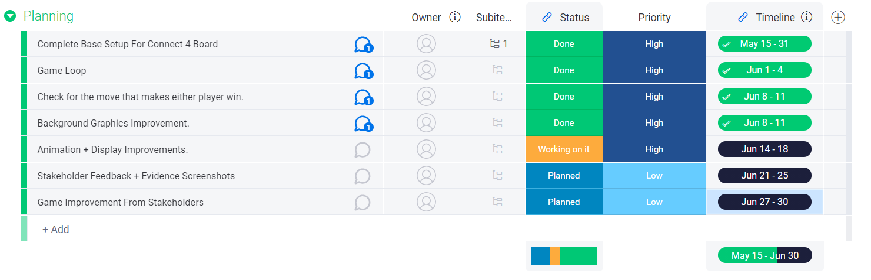
Updated Plan (as of 6/13/2021)

Slide 23
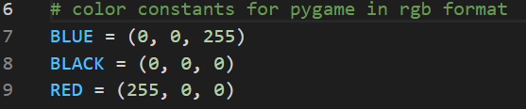
Color constants
I added these color constants in my code as the game will be put in a GUI format via pygame. RGB formatting is used for this.

Slide 24
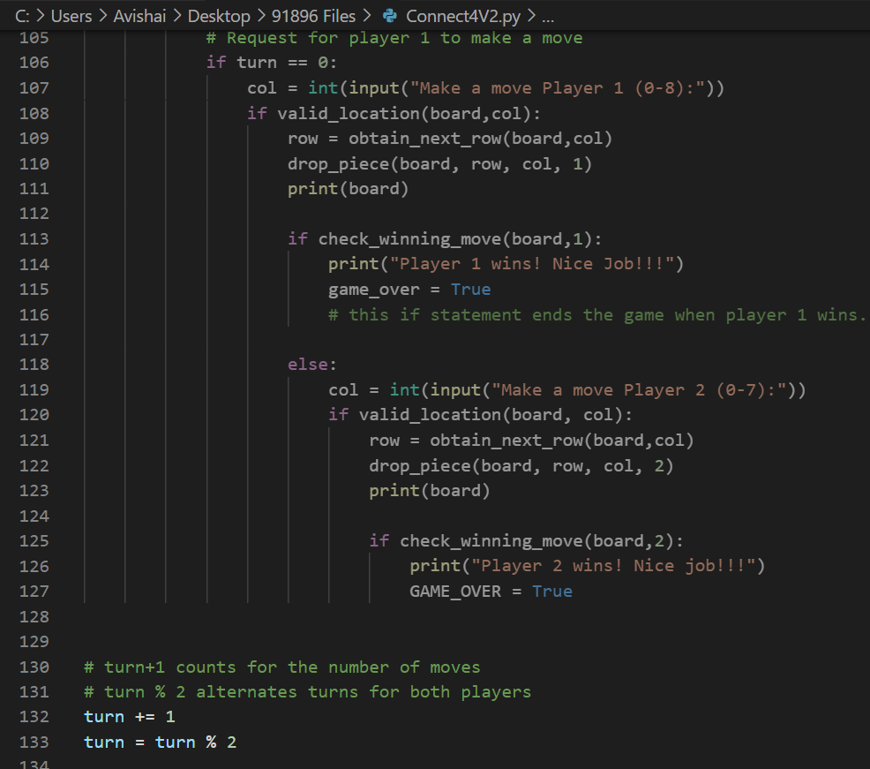
GUI Major Improvement
Code before

Slide 25
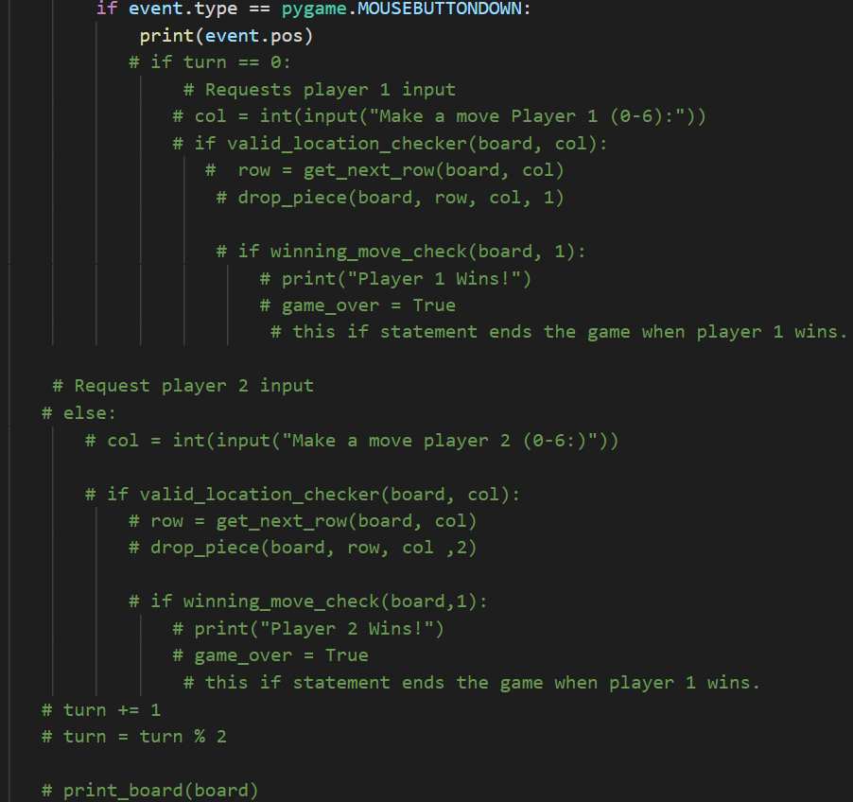
GUI MAJOR IMPROVEMENT
CODE AFTER (video form + screenshot)

Slide 26
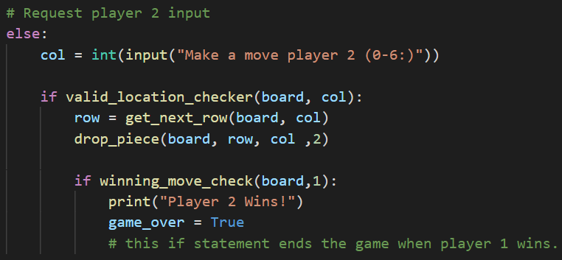
GUI INPUT CONVERSION (before in text format)

Slide 27

GUI INPUT CODE AFTER
I did this as I followed pygames documentation of position placement for a connect four game. In the col line, posx is divided by square (100px) as the values should equate to 7 instead of values like 700.

Slide 28

Major addition to code
Pygame mouse motion is to make sure that wherever the cursor is, the connect four piece follows with the cursor regardless if it’s either player 1 or 2.

Slide 29
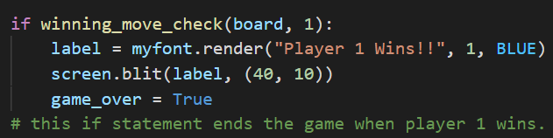
WINNING MOVE CODE CHANGE
I changed my winning move change to show a statement in the pygame GUI by defining a label tag.

Slide 30
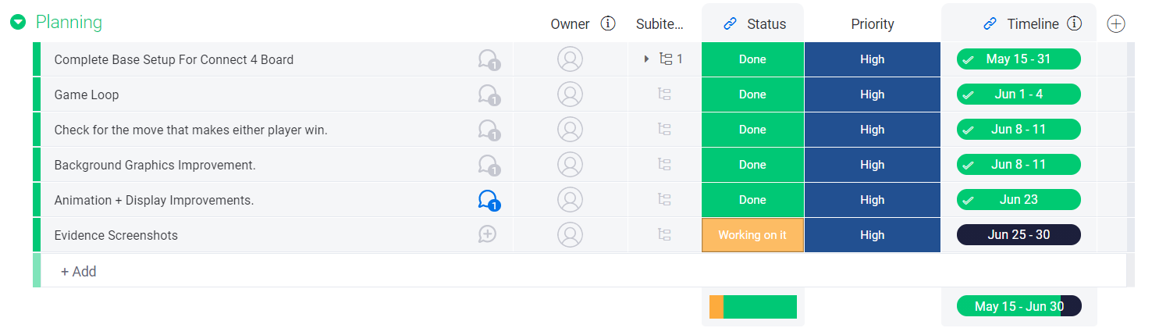
Planning (Final Full Game Development Update)

Slide 31
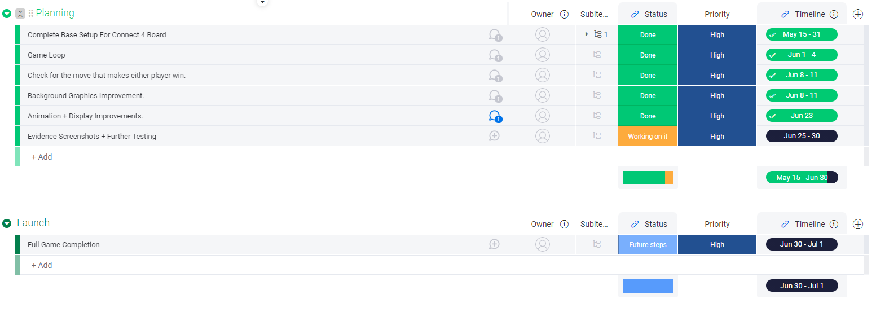
Fully Finalized Plan (6/23/21)

Slide 32
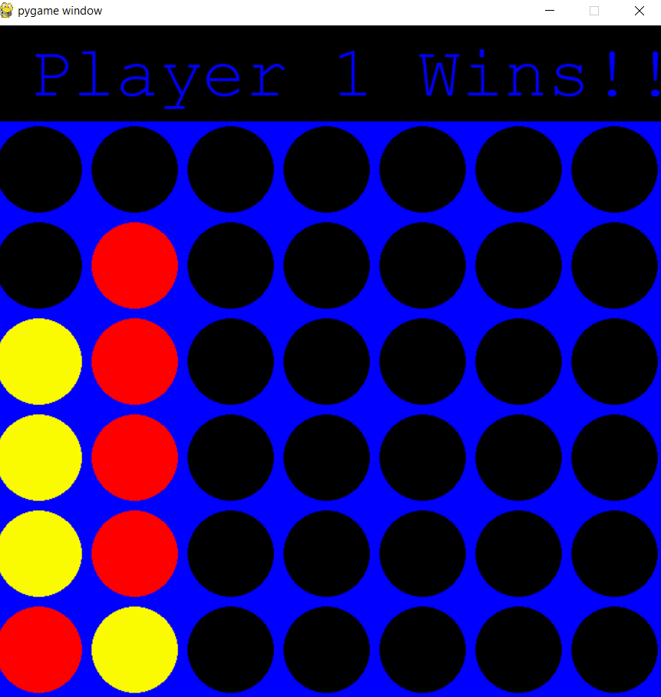
GAME WINNER FONT MINOR CHANGE IMPROVEMENT BEFORE
The font initially was monospace

Slide 33
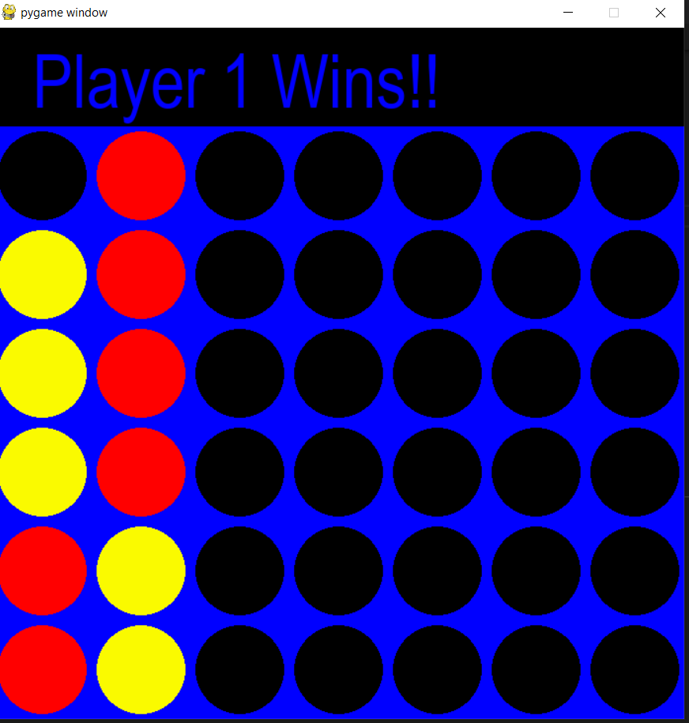
New Font Now (After)
I changed my font to a default arial because monospace may not be readable for all users, so I used a standard font instead. Another reason I used arial is because instead of using arial is that compared to monospace, arial is more thick which is more visible and readable.

Slide 34
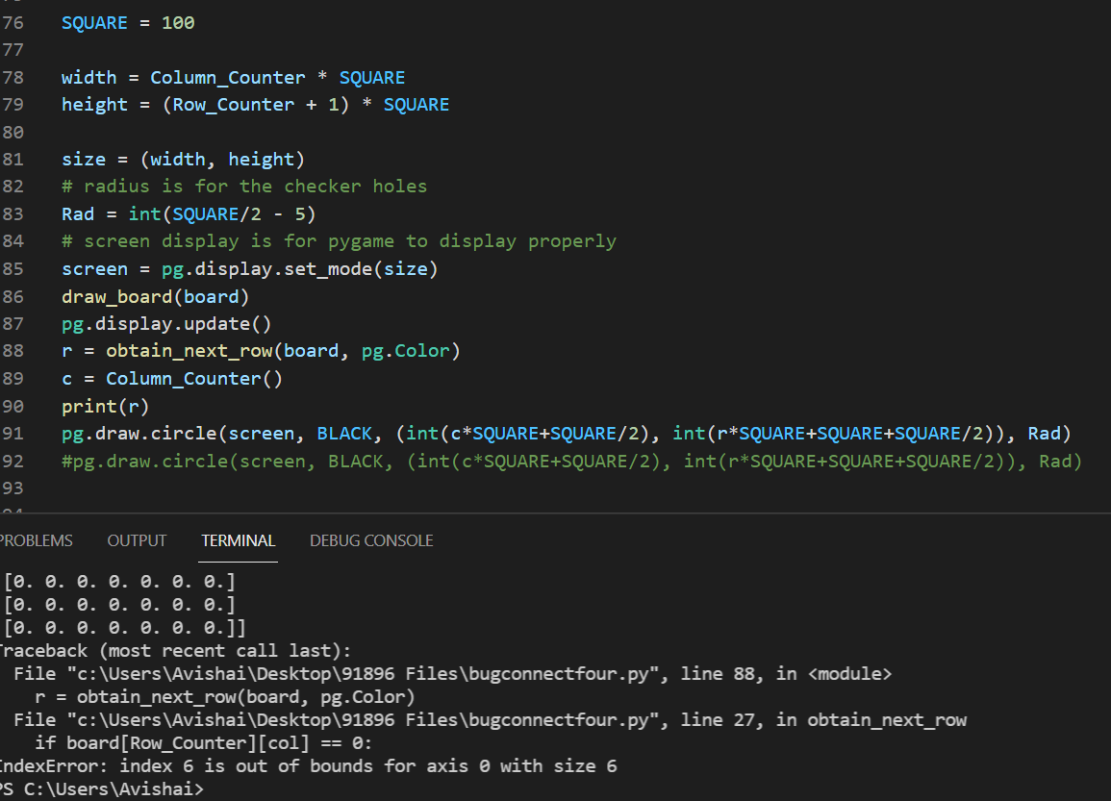
Pygame Initiate Code Glitch Before

Slide 35
Code Fix After
https://streamable.com/6g2ouw
Now, the problem before is that some key lines were outside of the def loop. Here’s my code now.

Slide 36
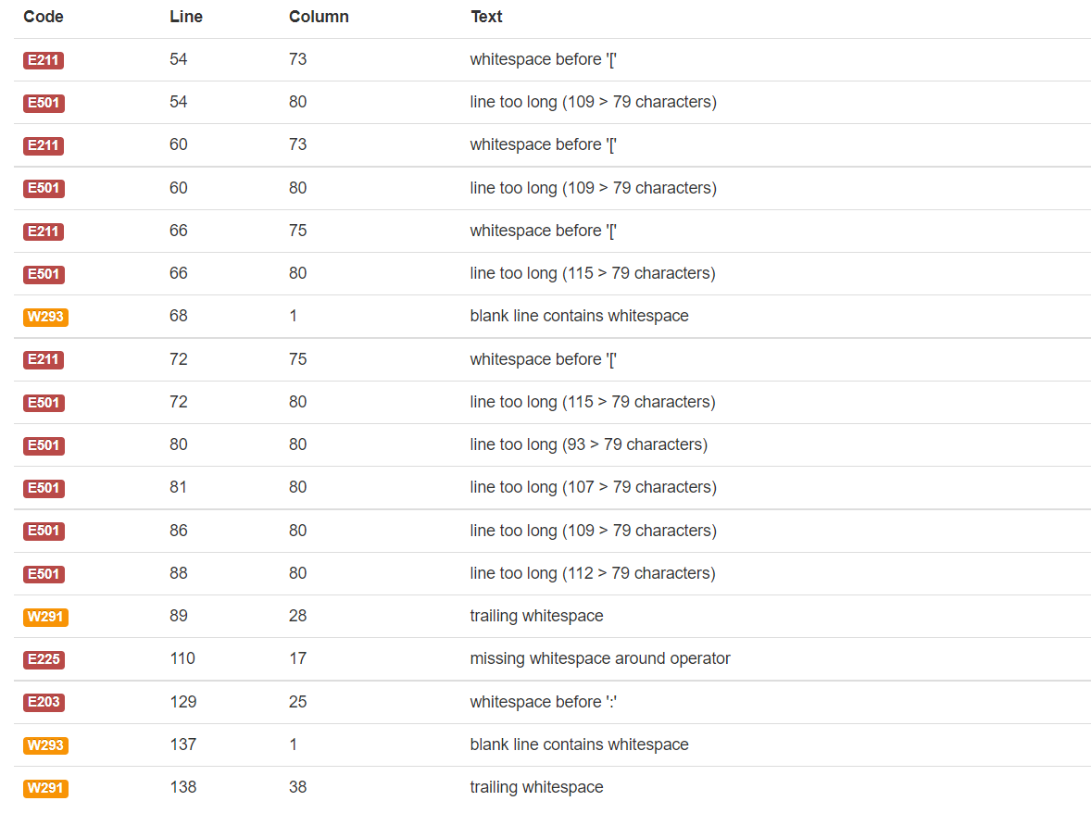
PEP8 VALIDATION (AS OF 6/24/21)

Slide 37
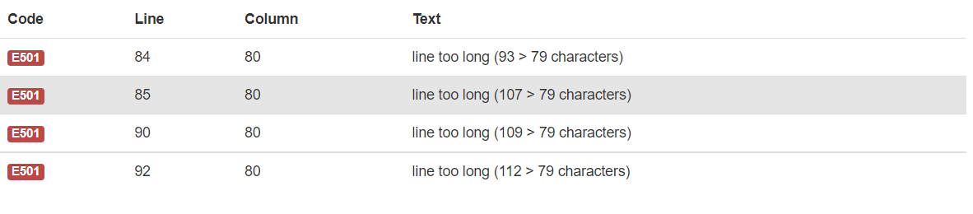
Nearly Fully Validated Code
https://streamable.com/sacgza
Remaining Errors:

Slide 38
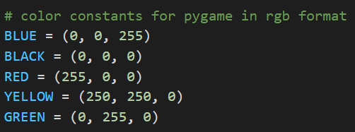
All colors used in code (6/28/21)

Slide 39
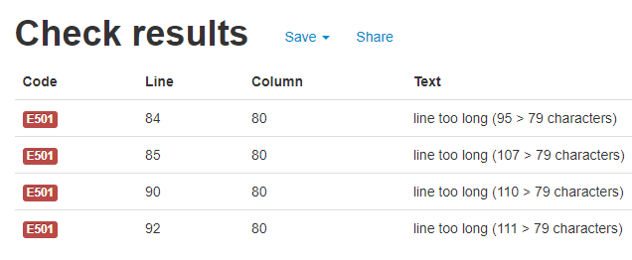
REMAINING PEP8 CONVENTION ERRORS(30/6/21)

Slide 40
FULL CODE NOW AFTER CLEAN CONVENTIONS
Screen recording of final code is here:
https://streamable.com/b2d0s2
In the errors in lines 84, 85, 90, and 92 were fixed by autopep fix command as the error was that the lines were too long.

